Slide 1
NAPA Agile Story: From Zero to Hero in Two Years
Toivo Vaje
@ToivoVaje
agilehope.blogspot.com
#NAPA
#SAFe
Notes:
Inspect and Adapt

Slide 2
Main achievements
Transparency increased on all levels
Delivery cycle time down from >12 months to 3 months
Increased predictability (2014 92% successful releases)
Need for patches decreased
Less defects in main branch
Good basis for further growth

Slide 3
Context: NAPA IN NUMBERS
200 EMPLOYEES
11 COUNTRY OFFICES
WORLDWIDE
95%
OF SHIPS BUILT ANNUALLY ARE DESIGNED BY OUR CUSTOMERS USING NAPA
Software
>25 YEARS
3 DEVELOPMENT
SITES
Notes:
Just one slide about where I come from.
We make software for maritime sector. We are global.
We have been here for a while and we have customers.
Respectful established company.

Slide 4
The Beginning
Found by 7 people working at Wärtsilä shipyard in 1989
Unique and superior solution for the initial design part of ships including calculations.
Global from the start
Became the de facto standard
Notes:
Found by 7 people from Wärtsilä. Unique and superior solution for the initial design part of ships including calculations.

Slide 5
Growth Pain
Annual big major releases
Projects (a lot of)
Variable scope and schedule
Structures missing
Notes:
Mode of operation still resembles small company. Release schedules slip. It’s difficult to get sw out.

Slide 6
Organizational Change
Basic Scrum training for all developers
Every Product Owner and Scrum Master certified
Communities of Practice for Scrum Masters and Testers
Scrum not enough. Shortly started implementing SAFe®
Infrastructure handled by System Team
Leading SAFe (SA) trainings by Nitor Delta

Slide 7
Applying Scaled Agile Framework® @NAPA
Portfolio Funnel. New ideas that are approved end up as Roadmap Themes.
Team metrics: velocity, bugs, forecast hit-rate
Program metrics:
Number of succesful releases, release test execution-%, bugs found in master & released products
Product Management:
Owners of Roadmap, bridge between customers and company. Headed by Chief Portfolio Officer.
Release Team Manager
Quarterly Releases
Release Team:
Continuous integration, installers, JIRA & other tools, releases & patches, version control
Whole company Release planning
Product Teams:
Product Owner and Developers (one is Scrum Master)
Sprints. Mostly two weeks. Not synchronized.

Slide 8
NAPA Technology 2/2012
Product Owners
(in Business Units)
Log / Voyage
Nn
Ship
Model
nn
Statutory
nn
Steel
nn
Hydro
Nn
Report. & Office
nn
Finland
India
Romania
Software Development Process
nn
Statutory
Nn
Nn
Nn
Nn
Nn
Nn
Nn
Nn
Nn
Reporting & Office
nn
nn
nn
nn
Ship
Model
Nn
Nn
Nn
Nn
Nn
Nn
Hydro
Nn
Nn
Nn
Nn
Nn
Log / Voyage
Nn
Nn
Nn
Nn
Nn
Steel
Nn
Nn
Nn
Nn
Nn
Nn
Nn
Nn
Nn
Release Team
nn
Platform &
Architecture
nn
Notes:
How NAPA Technology organization looked after the transformation. Tools and practices shared between teams working on same product. Many distributed teams.

Slide 9
Team Structure
All teams starting with pure Scrum
Every team had own Product Owner, Scrum Master and Backlog
Many distributed teams

Slide 10
How we make Releases Now
Fixed:
Release Cycle
Quality
(Resources)
Stabilization Period
Scope is the only variable
http://www.scaledagileframework.com/develop-on-cadence-release-on-demand/
Notes:
For us Release is a Project. We have well defined processes so by every iteration we learn to do things better.

Slide 11
Different Levels of Abstraction
Is part of a larger entity
Splits down into Sprints
Notes:
It’s important to understand the relation between different concepts.

Slide 12
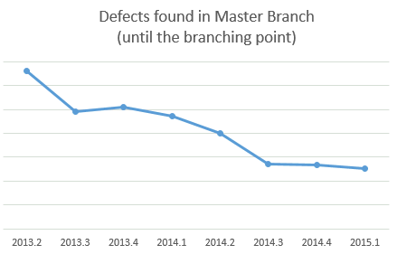
Reliability First
Testing more efficient
Transparently measuring test execution
Less patches needed

Slide 13
Tools are important
Notes:
In distributed setup tools play an important role.
Either you have visibility or you don’t.

Slide 14
Split work between Product Owner and Product Manager 5/2013
Both customers and teams benefit
Notes:
Although this is generally considered antipattern, we decided to separate the roles of Product Manager and Product Owner.
Both customers and teams benefit.

Slide 15
Product Manager
Product Roadmap & Vision
Long term plans (big rocks)
Close contact with customers
http://www.scaledagileframework.com/product-management/
Notes:
Product Roadmap & Vision
Long term plans (big rocks)
Close to customers

Slide 16
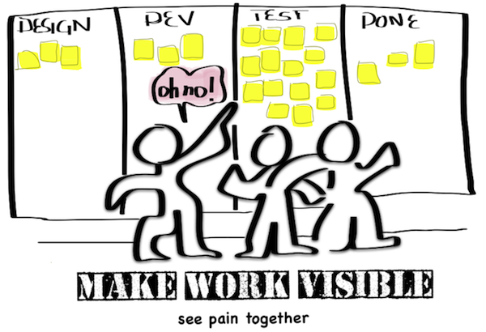
Release Train Engineer
Facilitates Release events
Gathers results
Makes things visible
http://www.scaledagileframework.com/rte/
Notes:
Facilitates Release events
Gathers results
Makes things visible
SAFe and Henrik Kniberg

Slide 17
Contents
History -2012
Organizational change 2012
Release Planning Days 2014-
Increasing Transparency
Notes:
We started Release Planning Days in 2014. The whole company attends.

Slide 18
Release Planning
Whole company together
Event called Release Planning Day
http://www.scaledagileframework.com/release-planning/
http://agilehope.blogspot.com/2014/05/release-planning-day.html
Notes:
Alignment
Shared Vision
Linking different abstraction levels
Communication

Slide 19
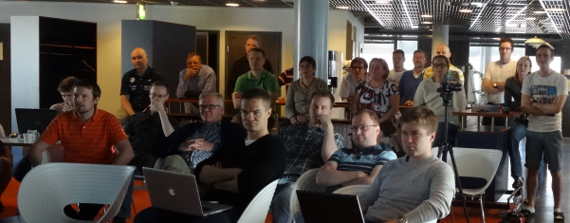
Release Planning Day
Whole company together

Slide 20
Release Planning Day Rough Schedule
Common event
Day 1
9-9:15 | Business Context
9:30-10:30 | Product Roadmaps
10:30-10:45 | Planning Process and Requirements
10:45-12 | Team Breakout #1
12-13 | Lunch
13-14 | Draft Plan Review
14- | ( Team Breakout #2 + Problem Solving & Adjustments )
 | End of Day 1
Day 2
 | Team Breakout #2 + Problem Solving & Adjustments
10:30-> | Final Plan Review
 | Vote of Confidence & Plan rework if needed

Slide 21
Conclusions & What works
Co-located teams
Dedicated POs
Increasing Transparency
Working together
Notes:
You probably don’t hit all the targets with one shot.
Well defined processes help repeatability
Empower people to make daily decisions
Continuously improve your operations
25 years
11 product teams
33/36 successful product releases
Automated test coverage increased +38% since 2012
Everyone in the company participates in Release Planning

Slide 22
Enjoy Working Together!
Every six months we arrange NAPA Hackathon (24 hour coding/idea event)
Anyone can introduce an idea and get whole company’s attention for 5 minutes
Blog post about how we did it in practice: http://agilehope.blogspot.com/2014/06/how-we-arranged-hackathon.html
http://www.scaledagileframework.com/innovation-planning/
Notes:
One of our core values at NAPA is that people Enjoy Working Together.

Slide 23
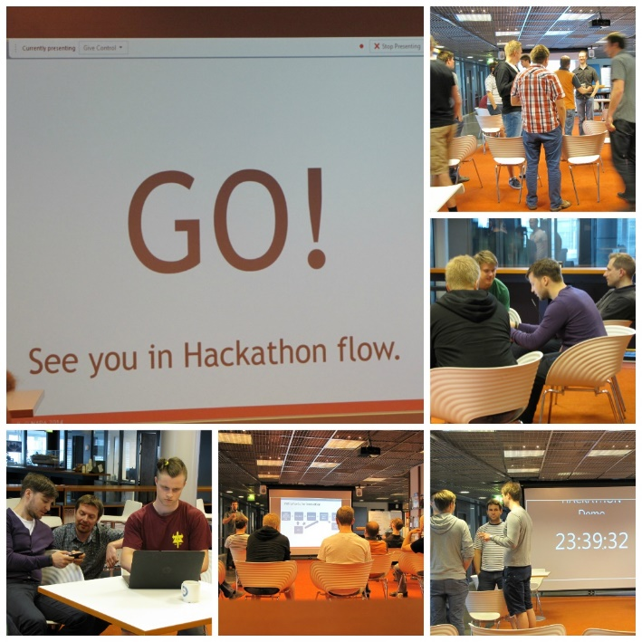
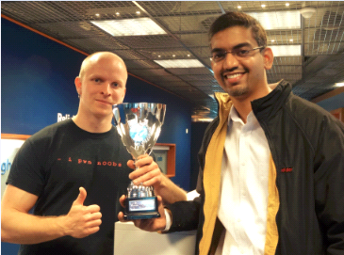
Enjoy Working Together!

Slide 24
SAFely forward!
http://www.napa.fi/

