Slide 1
Introducing the
Scaled Agile Framework® (SAFe®) for Lean Enterprises
3/7/2018

Slide 2

Digital disruption is affecting every industry across the globe.
© Scaled Agile, Inc.

Slide 3
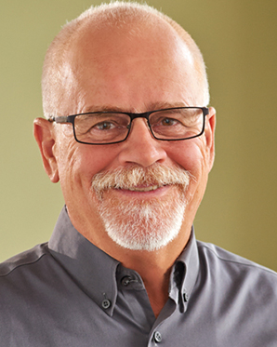
“Every business is a software business now.
Agility isn't an option, or a thing just for teams, it is a business imperative. But we struggle building big systems … “
—Dean Leffingwell
Creator of SAFe

Slide 4

Too early commitment to a design that didn’t work
Problems discovered too late
Too little
visibility
How can we compete when our retrospectives read like this?
No way to improve systematically
Hard to manage distributed teams
Dissatisfied
customers
Late
delivery
Under-
estimated dependencies
Poor
morale
Massive growth in complexity
Phase
gates don’t reduce risk
Notes:
One of the results, especially as we build systems that are larger and more complex, is that our retrospectives are still troublesome. And that means our results are still troublesome.
Sometimes they look like this: [read through some of the sticky notes on the slides]
The net result is that when we don't deliver large systems on time and on schedule with the requisite quality, we have poor morale. And what do you think the impact is of poor morale on the development environment?
It makes everything worse.

Slide 5
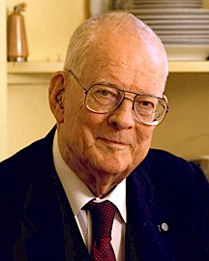
Management’s challenge
It is not enough that management commit themselves to quality and productivity. …
They must know what it is they must do.
Such a responsibility cannot be delegated.
—W. Edwards Deming
“… and if you can’t come, send no one.”
—Vignette from Out of the Crisis, Deming,1986
Notes:
It’s clear we need something different.
We're going to talk today about systems thinking and Lean product development and Agile development.
This is from Deming, the quintessential leader of this field:
"It is not enough that management commit themselves to quality and productivity. … They must know what it is they must do."
Further on in this book, the famous 1982 book Out of the Crisis Deming says,
"Such a responsibility cannot be delegated."
What does that mean?
It means that we, as the leaders, have the ultimate responsibility for implementing the change in the organization. It is our leadership that will make that effective.
Later in the book there's a discussion between one VP of manufacturing to another. The one VP has a stellar quality record, and the other one not so much. So the second VP said to the first, "Can I visit? Can I come see your plant and learn your secrets?"
And the first VP replied, "Absolutely. But if you can't come, send no one."
What did he mean by that?
It's pretty clear: This is not a responsibility that can be delegated.
The lessons for you leaders out there, you change agents and those of you who have decided to take this initiative to your large enterprise, and to make the changes to improve quality and productivity.

Slide 6
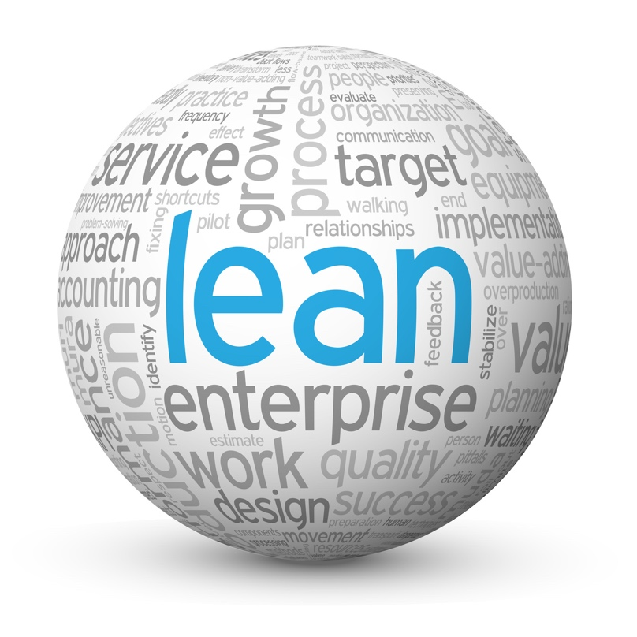
What it is they must do
Embrace a Lean-Agile mindset
Build the Lean Enterprise
Lead the transformation
Get results
Notes:
So what is it that they—we—must do?
There are certainly plenty of opinions on that. We'll share ours:
Number one: Embrace a Lean-Agile mindset.
Number two: Implement Lean-Agile practices.
Thirdly: Lead the implementation.
And we're confident that if you do those things, you'll get the results you deserve.
Let's talk about each of these three things…..

Slide 7



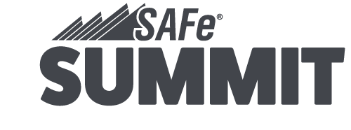
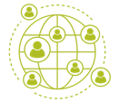







Why SAFe?
250,000
180
Freely Available
SAFe’s knowledge base is freely available at scaledagileframework.com
SAFe-trained
professionals
in 110+ countries
Scaled Agile Partners
in 50 countries
Configurable
SAFe is able to accommodate enterprises of all
sizes and industries
Training
70%
A comprehensive role-based curriculum
for successfully implementing SAFe and skills validation through professional certification.
US Fortune 100 enterprises have
SAFe-trained professionals
Fastest Growing Method
2 million
SAFe cited as preferred solution for scaling Agile:
• 2017 Agile in the Enterprise survey by Gartner Research
• 12th Annual State of Agile Report by VersionOne
• 2017 Scaling Agile Report by cPrime
Pledged 1%
Scaled Agile stock equity & employee time to Pledge 1% campaign
Annual visitors to SAFe
and Scaled Agile websites
SAFe CASE STUDIES
30 - 75%
25 - 75%
20 - 50%
10 - 50%
Faster
Time-to-Market
Increase in
Productivity
Improvements
in Quality
Increased Employee Engagement
February 2018 © Scaled Agile, Inc..

Slide 8
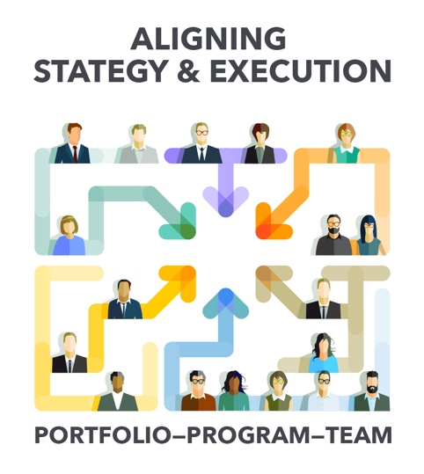
SAFe is the world’s
leading framework for enterprise agility
SAFe is a knowledge base of proven, integrated principles and practices for Lean, Agile, and DevOps.
scaledagileframework.com

Slide 9
Embrace a Lean-Agile mindset
Notes:
First, let's discuss embracing a Lean-Agile mindset.

Slide 10
Embrace Lean-Agile values
House of Lean
Agile Manifesto
VALUE
We are uncovering better ways of developing software by doing it and helping others do it. Through this work we have come to value:
Individuals and interactions over processes and tools
Working software over comprehensive documentation
Customer collaboration over contract negotiation
Responding to change over following a plan
Respect for
people and culture
Relentless
improvement
Flow
Innovation
LEADERSHIP
Value in the shortest
sustainable lead time
That is, while there is value in the items on the right, we value the items on the left more.
Notes:
Our Lean-Agile mindset is represented in two things:
(1) The House of Lean, which you see here. It has a number of elements:
Value, because the goal of Lean is very simple: value, and the shortest sustainable lead time.
That's accomplished by the pillars of respect for people and culture, product development flow, innovation—critical to long-term sustainability—and relentless improvement.
And it's supported by leadership.
That's the structure in which we tend to think about the Lean paradigm.
---
(2) Secondly is the Agile Manifesto, which has been with us now since 2001 It's a very well-written document, and what it says is still true today. We need the Agile Manifesto because it's the key to unlocking the motivations and the talents of the knowledge workers who develop our solutions and software.
And it states specifically,
"Individuals and interactions over processes and tools." Because talking matters.
"Working software over comprehensive documentation."
"Customer collaboration over contract negotiation."
And "Responding to change over following a plan."

Slide 11
SAFe Lean-Agile Principles
#1 - Take an economic view
#2 - Apply systems thinking
#3 - Assume variability; preserve options
#4 - Build incrementally with fast, integrated learning cycles
#5 - Base milestones on objective evaluation of working systems
#6 - Visualize and limit WIP, reduce batch sizes, and manage queue lengths
#7 - Apply cadence, synchronize with cross-domain planning
#8 - Unlock the intrinsic motivation of knowledge workers
#9 - Decentralize decision-making
Notes:
So let's discuss the Lean-Agile principles that underlie SAFe.
[Read through each of the principles on the slide]
We don't have time in presentation to drill into each of these, but if you head down the SAFe journey, it will be important to learn why these principles are so critical to a successful implementation of SAFe.
They are so important because principles trump practices.
So if we're struggling with a practice, we're going to return to these basic principles to make sure that we're trying to build a system and an implementation that is as Lean and Agile as possible.
You can learn more about SAFe Lean-Agile Principles at http://www.scaledagileframework.com/safe-lean-agile-principles.

Slide 12








Building incrementally accelerates value delivery
Requirements
Design
Implementation
WATERFALL
Verification
4
444
:
Documents
Documents
Unverified System
System
Incremental
Delivery
Notes:
On the previous slide, we said that Number 1 was to take an economic view.
Here's a first look at the economics of Agile development.
Specifically: Building incrementally accelerates value delivery.
Traditionally, we looked at things as a series of steps. Our traditional waterfall life cycle had us doing what made sense: We did our requirements, our design, our implementation, and our verification—in that order. It's hard to argue with that; you couldn't do the implementation before you did the requirements, for example.
But we've learned a few things in the last couple of decades, and we now understand that it's possible—with the right constructs, the right thinking, and the right culture—to develop and deliver incrementally….
…. that's the basic nature of Agile and Lean development, as compared to our traditional development models.

Slide 13
And delivers better economics
Early delivery provides fast value with fast feedback
Fast feedback
Waterfall
Value Delivery
Incremental
Time
Notes:
The result is much better outcomes because each incremental delivery produces some value very early.
Notice that it's very early compared to waterfall, where even if we execute perfectly we're not getting any value till the end.
But that little box doesn't go away; it stays. It delivers value throughout the time. And if you think about it, this is the integral value of all the value we've delivered to our customer before we even reach what would have been the waterfall deadline.
That's a pretty compelling case. It means that even if you executed waterfall perfectly—and that's pretty hard to do—you still can't compete with the better economics of Agile development.
-------
[Note: On this slide, it is helpful to illustrate this concept if possible by walking through and drawing on each box to illustrate the benefits of incremental delivery]

Slide 14
Build the Lean enterprise
Notes:
Next, let's talk about implementing Lean-Agile practices.

Slide 15
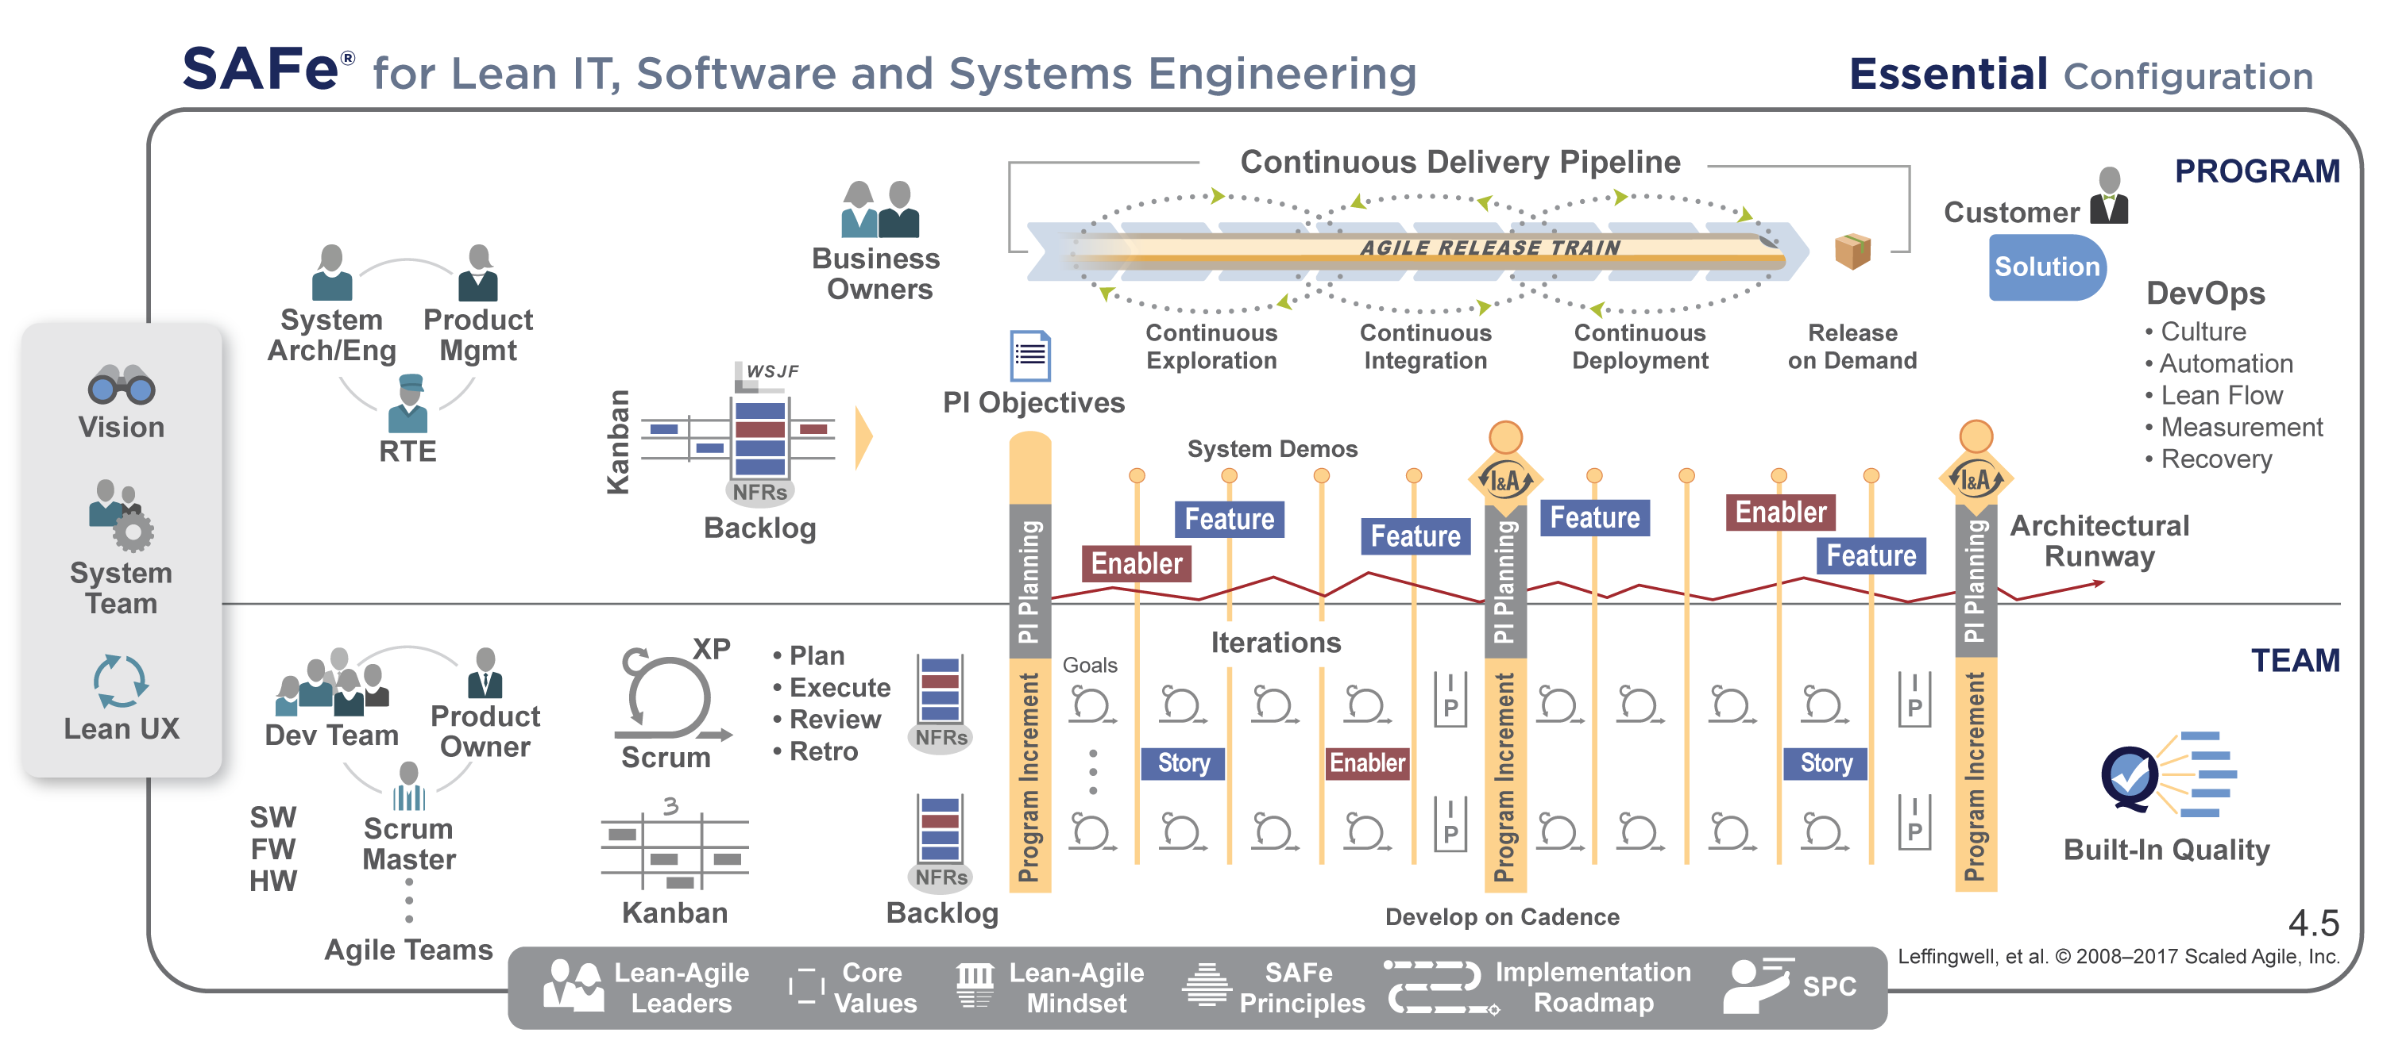
Start with Essential SAFe
System Demo
Real Agile Teams and Trains
6
Cadence and Synchronization
2
3
DevOps and Releasability
5
7
Inspect & Adapt
9
Architectural Runway
4
PI Planning
Lean-Agile Leadership
10
Lean-Agile Principles
8
IP Iteration
1
Notes:
The Framework’s simplest configuration, Essential SAFe provides the core practices and roles needed to ensure business results. Learn more at http://www.scaledagileframework.com/essential-safe

Slide 16



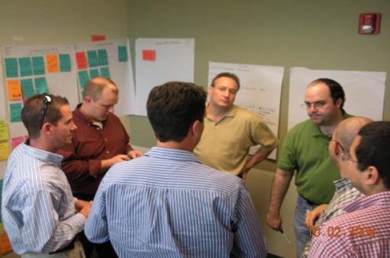

Nothing beats an Agile Team
Cross-functional, self-organizing — can define, build, and test valuable things
Applied Agile Software Engineering practices with XP, Scrum,
and Kanban
Delivers value every two weeks
Do
Check
Adjust
Plan
Team 1
PDCA
Team n
Notes:
It all starts with the Agile Team.
You see the teams here on the left, and you notice immediately that they're cross-functional. They work together. They're collocated whenever possible, and they execute the basic scientific method of Plan, Do, Check, and Adjust.
They're cross-functional, largely self-organizing, and largely self-managing.
They can define, build, and test a thing of value. They apply that basic scientific practice in what we call iterations, or sprints: plan, do, check, adjust.
They do that on a cadence, they do it frequently, they do it routinely. Really, that's all they do; that is their development model. Plan, do, check, adjust, and deliver value every two weeks.

Slide 17
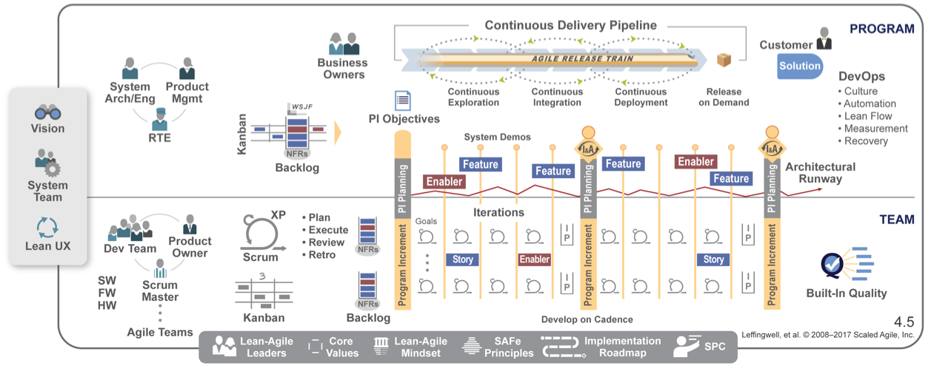
Except a team of Agile Teams
Align 50 - 125 practitioners to a common mission
Apply cadence and synchronization, Program Increments every 6 - 12 weeks
Provide Vision, Roadmap, architectural guidance
D
C
A
P
D
C
A
P
D
C
A
P
D
C
A
P
D
C
A
P
D
C
A
P
D
C
A
P
D
C
A
P
Notes:
Previously we said “nothing beats an Agile Team”….. Actually though, there is one thing that beats an Agile Team. That's a team of Agile Teams.
They work together and take an approach that says, "Let's take these plan-do-check cycles, and let's accumulate those into larger cycles."
We call this the Agile Release Train.
The Agile Release Train aligns 50 to 125 practitioners to a common mission.
We apply cadence and synchronization, program increments every 6 to 12 weeks. So these sprints, or iterations in SAFe, add up very quickly into larger amounts of value.
We provide vision, roadmap, and architectural guidance. There may be 10 or 15 teams on this train.
For example: Let's say we're going to implement single sign-on…. We need to decide how to do that, and we want everybody to do it the same way to make sure that we don't introduce security holes in our single sign-on mechanism.

Slide 18






Bringing together the necessary people
Business
Product
Mgmt
Arch/
Sys Eng.
Program
Hardware
Software
Testing
Deployment
AGILE RELEASE TRAIN
Notes:
The ART truly takes a systems view.
It brings together the people we need to deliver larger amounts of value. That includes our business owners, our representatives from the customers, product management, architecture, systems engineering, hardware, software, testing, people involved in manufacturing or deployment of our solution…. We create this virtual program.
And the virtual program now has the skills they need. So the ART is cross-functional as well. And it typically contains about 50 to 125 people.

Slide 19
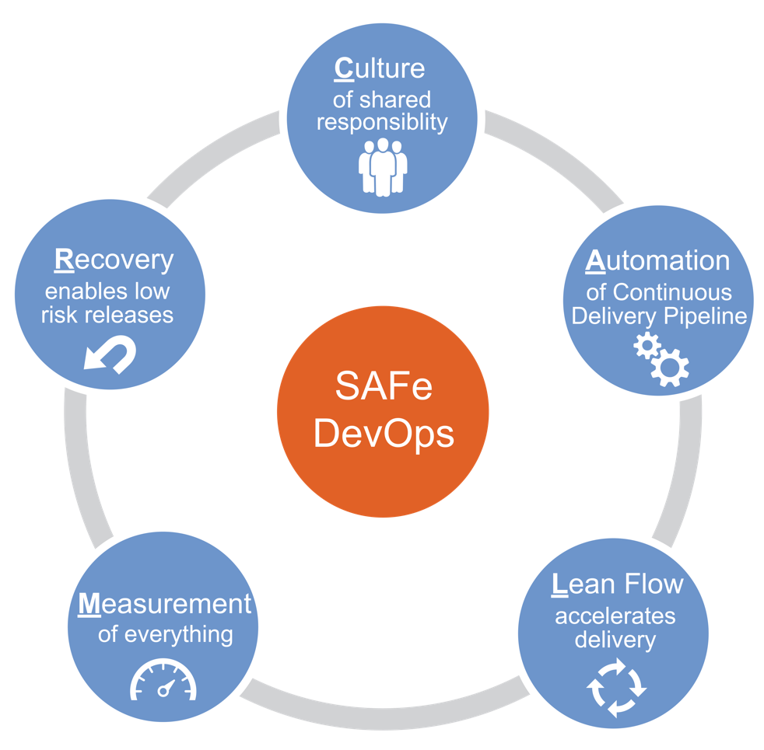
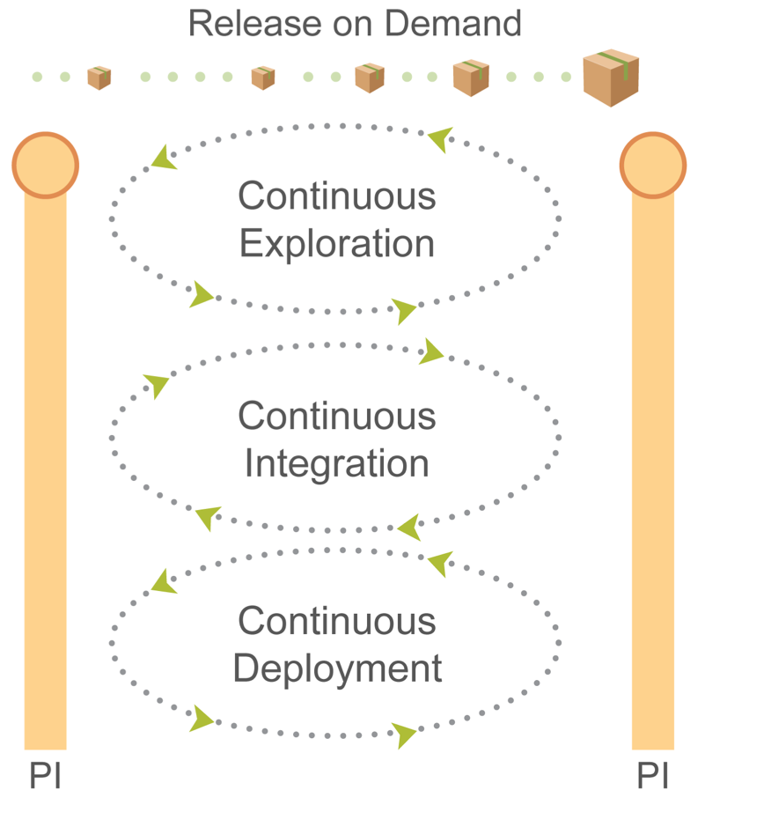
To deliver value continuously

Slide 20
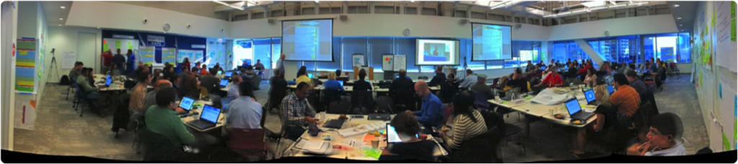
Synchronizing with PI Planning
Future product development tasks can’t be pre-determined. Distribute planning and control to those who can understand and react to the end results. —Michael Kennedy, Product Development for the Lean Enterprise
All stakeholders face-to-face (but typically multiple locations)
Management sets the mission, with minimum possible constraints
Requirements and design emerge
Important stakeholder decisions are accelerated
Teams create—and take responsibility for—plans
For a short video PI planning example, see: https://youtu.be/ZZAtl7nAB1M
Notes:
The ART synchronizes its work with PI Planning.
Michael Kennedy explained it as: "Future product development tasks can't be predetermined. Distribute planning and control to those who can understand and react to the end results."
Here you see a picture of a distributed planning session. There are actually three countries at work here. There's a large group in Mumbai, India; they're not present. There are a lot of folks from Chicago, and some leads and some managers from the teams in Serbia. They're all planning together over a two-day period.
Typically PI Planning is face to face, but, if it's a large organization, you may not be able to have everybody face to face every time.
Management sets the mission, with minimal possible constraints—that's a key philosophy of Lean Thinking.
Requirements and design emerge. We talk about emergent design as one of the key aspects of Agile, and it emerges here. We call this PI Planning, but there's far more than planning that happens. People collaborate, they determine new requirements, they negotiate teams and dependencies.
Business owners add features and take out features to manage scope. Important stakeholder decisions are accelerated in a day—not after six weeks of emails banging around, trying to find the right person to make the decision, but right now.
In this picture, one group of managers at a PI Planning had a sign that said, "Help Desk—we're here to help." That was a great underscored the important construct that if decisions need to be made, they could make those decisions.
Ultimately, teams create and take responsibility for the plans, and that's a big difference from our traditional command-and-control, centralized program-planning model. In this case, management sets the vision, but the teams create the plans.

Slide 21
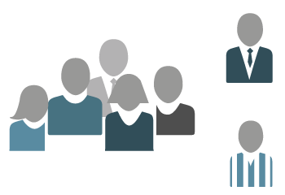
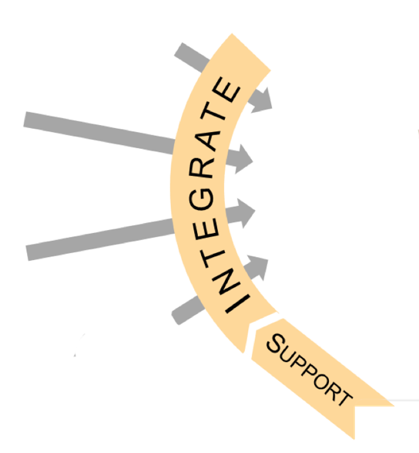
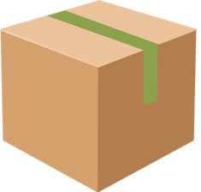
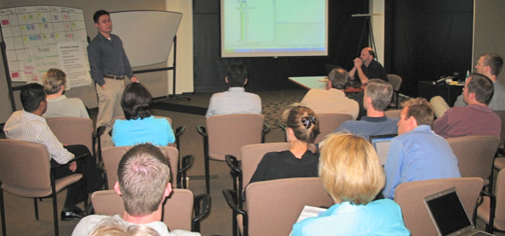

Demonstrating the full system every two weeks
An integrated solution demo
Objective milestone
Demo from the staging environment, or the nearest proxy
Full system
System
Team
Notes:
Then they start iterating.
They demonstrate the full system every two weeks— that's the typical increment length.
It's an integrated Solution Demo; it's all the aspects of the solution that you need in order to understand the progress. It's an objective milestone.
If the team can't build the system or show new functionality in a couple of weeks, something's probably wrong with their infrastructure or team configuration. Maybe they don't have the people they need. Maybe it's not a fully cross-functional team yet.
Also, they demo from the staging environment. As we move toward deployment, we want to make sure we're demoing from an environment that's very near the production or deployment environment.

Slide 22
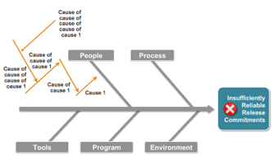
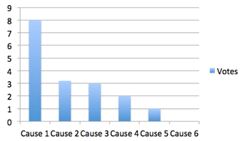


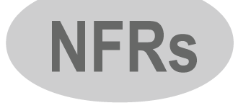
Inspecting and Adapting every PI
Every PI, teams systematically address the larger impediments that are limiting velocity.
Agree on the
problem to solve
Apply root cause analysis
(+ five whys)
Identify the biggest root cause using Pareto Analysis
Insufficiently reliable release commitments?
Restate the new problem for the biggest root cause
Brainstorm solutions
Identify improvement
Backlog items
Insufficient
architectural runway
Notes:
The teams inspect and adapt at every PI. They systematically address the larger impediments. They do so in a very structured problem-solving workshop:
Step #1 of the workshop is for teams agree on the problem to solve.
Step #2 is they apply root cause analysis.
Step #3 is they identify the biggest root cause using Pareto Analysis.
Step #4: Restate that root cause.
Step #5: If you're really close now, you can move directly to solutions.
But the most important step is:
Step #6, where they create backlog items and improvement stories to take into PI Planning. That way they can implement those improvements and see the benefits in velocity and productivity that those improvements help them achieve.

Slide 23
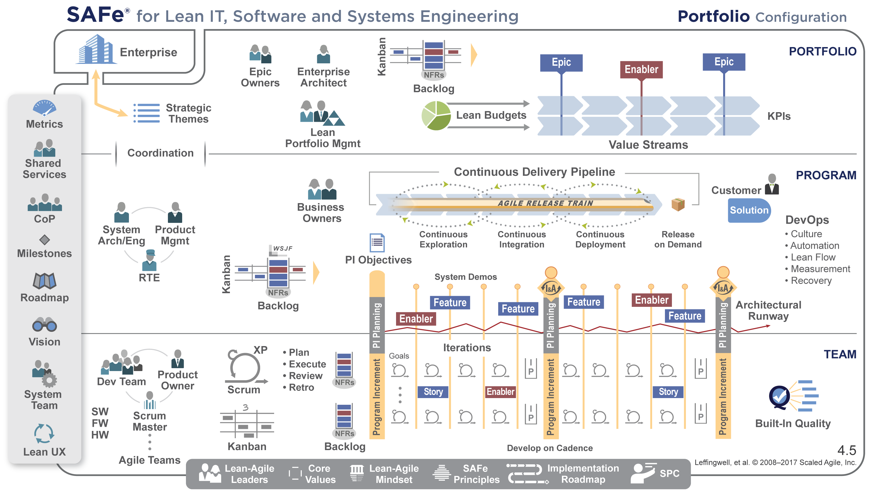
Align strategy and execution with Portfolio SAFe
Notes:
The Portfolio SAFe configuration is for enterprises that build multiple solutions which have minimal dependencies on one another, but require Portfolio-level coordination, strategy, investment, and governance.
At a Glance
Organized around the flow of value
Lean-Agile budgeting empowers decision makers
Kanban system provides portfolio visibility and WIP limits
Enterprise architecture guides larger technology decisions
Objective metrics support governance and improvement
Value delivery via Epics
Learn more about the Portfolio SAFe configuration at: http://www.scaledagileframework.com/portfolio-level.

Slide 24
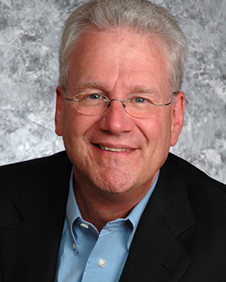
The Portfolio challenge
“Most strategy dialogues end up with executives talking at cross-purposes because … nobody knows exactly what is meant by vision and strategy, and no two people ever quite agree on which topics belong where.
That is why, when you ask members of an executive team to describe and explain the corporate strategy, you frequently get wildly different answers. We just don’t have a good business discipline for converging on issues this abstract.”
—Geoffrey Moore
Escape Velocity
Notes:
Trainer Guidance:
Most enterprises don’t have a clear understanding of strategy
Lean Portfolio Management aims to create that clarity

Slide 25

Apply SAFe Lean Portfolio Management
Connect the portfolio to enterprise strategy
Fund Value Streams
Establish portfolio flow
Strategy &
Investment
Funding
Support Agile PMO, LACE, RTE and
SM CoP
Coordinate Value Streams
Sustain and improve
Forecast and budget dynamically
Measure Lean portfolio performance
Coordinate continuous compliance
Agile
Portfolio Operations
Lean
Governance
Notes:
Trainer Guidance:
The Lean Portfolio Management (LPM) function has the highest level of decision-making and financial accountability for the products and Solutions in a SAFe portfolio.
An effective LPM function is necessary for SAFe success, but it is typically a function, not an organization. The people who fulfill these responsibilities may have various titles and roles. But this function usually includes the business managers and executives who understand the Enterprise’s financial position and are ultimately responsible for portfolio strategy, operations, and execution.
Key Message:
Note: LPM is significantly different than traditional portfolio management. In many cases, an existing legacy mindset—with annual planning and budgeting cycles and traditional measures of progress—severely inhibits the enterprise’s transition to agility.
In response, SAFe recommends seven transformational patterns to move the organization to the leaner, more effective approach described in the article Extend to the Portfolio. With this context in mind, we can move on to describing Lean portfolio management.
Read more at: http://www.scaledagileframework.com/lean-portfolio-management.

Slide 26
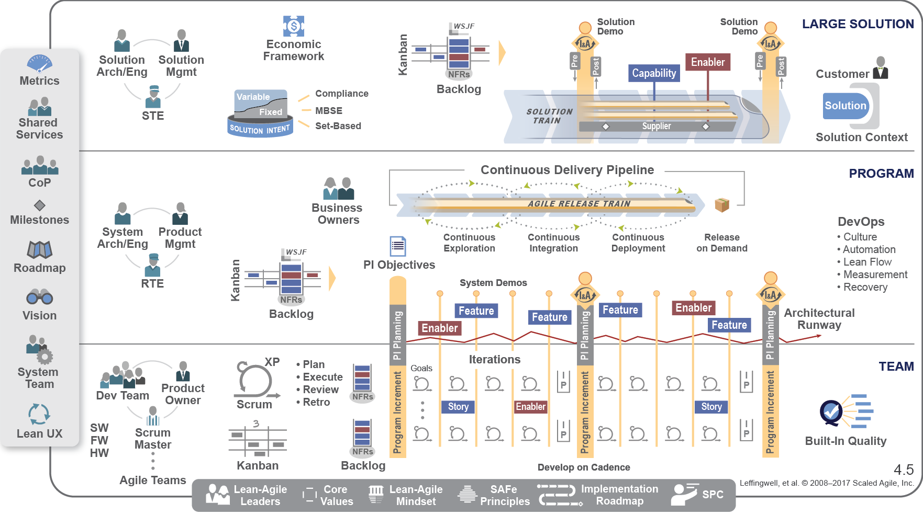
Build big systems with Large Solution SAFe
Notes:
Trainer Guidance:
The Large Solution SAFe configuration is intended for enterprises that are building large and complex solutions that require the contribution of multiple Agile Release Trains and Suppliers, but do not require the portfolio considerations.
This is common for industries like Aerospace and Defense, and Government, where they have very large programs, but do not need the constructs of the Portfolio level.
Key Message:
Coordinates development of large Solutions.
Synchronizes multiple ART Value Streams.
Manages Solution Intent.
Integrates suppliers as partners.
Value delivery via Capabilities.
Learn more about this configuration at http://www.scaledagileframework.com/large-solution-level.

Slide 27
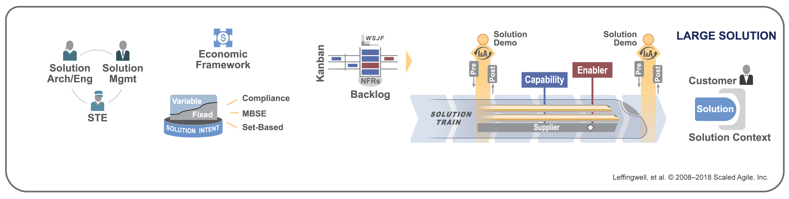
Apply Lean Systems Engineering
Solution Trains coordinate ARTs and suppliers
Capture fixed and variable Solution Intent
Integrate and test the full solution on cadence
Implement continuous compliance

Slide 28
Lead the transformation
Notes:
That's a brief overview of the Framework.
What is your role? Well, as I mentioned earlier, your role—our role—is to lead that implementation. Let’s take a look at that.

Slide 29
Leadership foundation
VALUE
People are already doing their best; the problems are with the system. Only management can change the system.
—W. Edwards Deming
Respect for
people and culture
Relentless
improvement
Flow
Innovation
LEADERSHIP
Notes:
Earlier we saw House of Lean and its Leadership foundation. And we talked about the inspiration that Deming has provided us.
I think this is another inspirational Deming quote: "People are already doing their best; the problems are with the system. Only management can change the system.”
What does that tell us?
It says that we've hired good people, we've motivated good people. The problems they're encountering in the workplace are systematic [systemic?] problems. They're problems with the system they're working in. And that means that it's up to management to take responsibility for evolving those systems.
We need you to lead the change. We need you to lead the implementation.

Slide 30
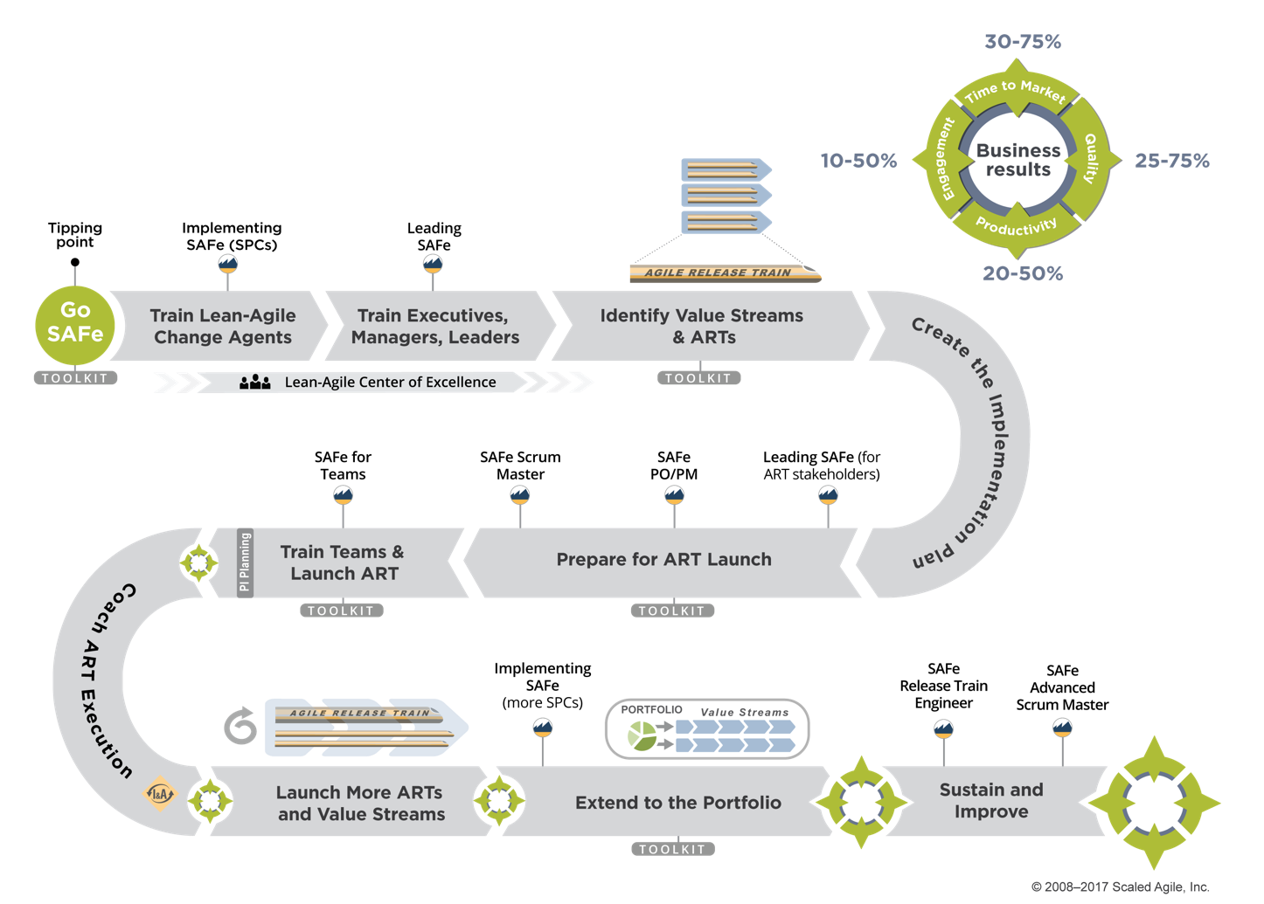
Follow the SAFe Implementation Roadmap
Notes:
Finally, let's discuss implementation. We'll describe that using our SAFe Implementation Roadmap.
The Roadmap describes a series of steps, or ‘critical moves,’ an enterprise can take to ensure a reliable and successful SAFe rollout. The steps are designed to be repeatable in order to support lifelong learning and relentless improvement of value delivery.
After making the decision to go SAFe, number 1 is to train the Lean-Agile change agents. We call those SAFe Program Consultants.
With a sufficient staff of Lean-Agile change agents onsite, and working with your partners, you'll have the ability to train the executives and leaders and managers—the people responsible for managing the people who deliver value.
They'll then be in a position to support the launch of the Agile Release Trains. And one train at a time, you'll build that Agile portfolio.
Learn more about the Roadmap at http://www.scaledagileframework.com/implementation-roadmap.

Slide 31
Get results
Notes:
And when you do this, you’ll see results …

Slide 32
Business results
10 – 50% happier,
more motivated employees
30 – 75% faster time-to-market
ENGAGEMENT
TIME-TO-MARKET
PRODUCTIVITY
BUSINESS RESULTS
QUALITY
20 – 50% increase in productivity
25 – 75%
defect reduction
See scaledagileframework.com/case-studies
Notes:
You'll get results like these:
Happier, more motivated employees
30 to 75% faster time to market
50%-plus defect reduction, and a
20 to 50% increase in productivity.
These are some pretty impressive results results and may sound like something that’s tough to believe or marketing hyperbole…..

Slide 33
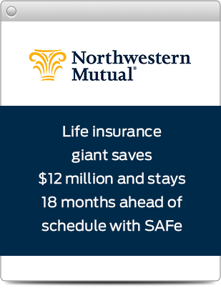
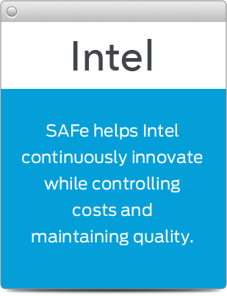
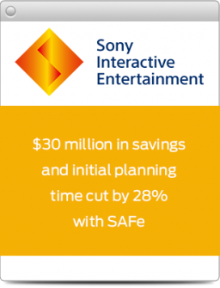
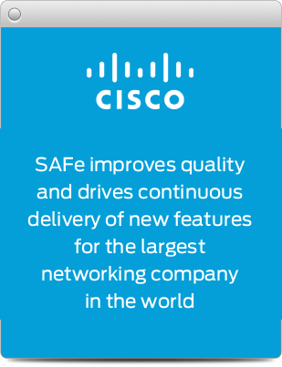
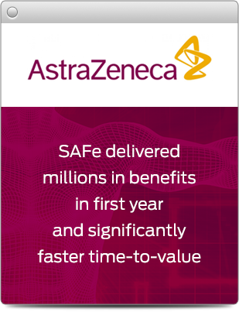
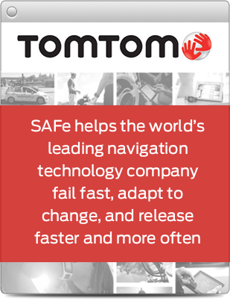
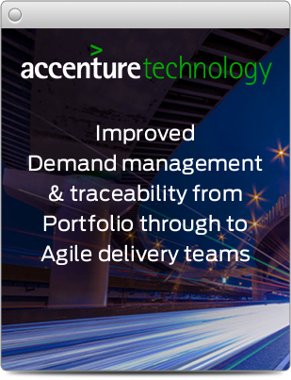
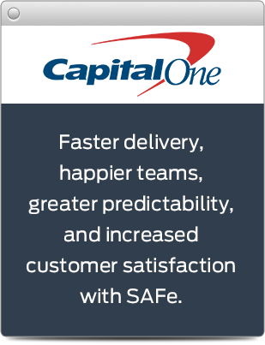
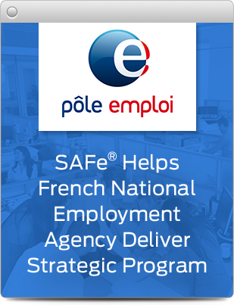
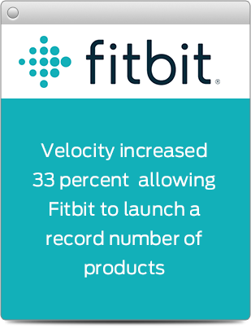
Financial Services / Electronics / Software / Telecom / Retail & Distribution / Government / Healthcare / Insurance / Medical Technology / Pharmaceutical / Media / Manufacturing / COTS Software / Customer Care & Billing / Outsourcing
See scaledagileframework.com/case-studies
Notes:
…. except that these numbers and results come from the companies themselves.
We don’t influence them. We simply gather the data from the enterprises and publish them.
Go to the website and you’ll see over 40 documented case studies on SAFe right now.
scaledagileframework.com/case-studies

Slide 34
Gain the knowledge
Gain the Knowledge
Notes:
Your next step is to gain the knowledge.
You can find SAFe training worldwide at scaledagile.com, and you can explore the SAFe knowledge base and find other free resources at scaledagileframework.com.

Slide 35

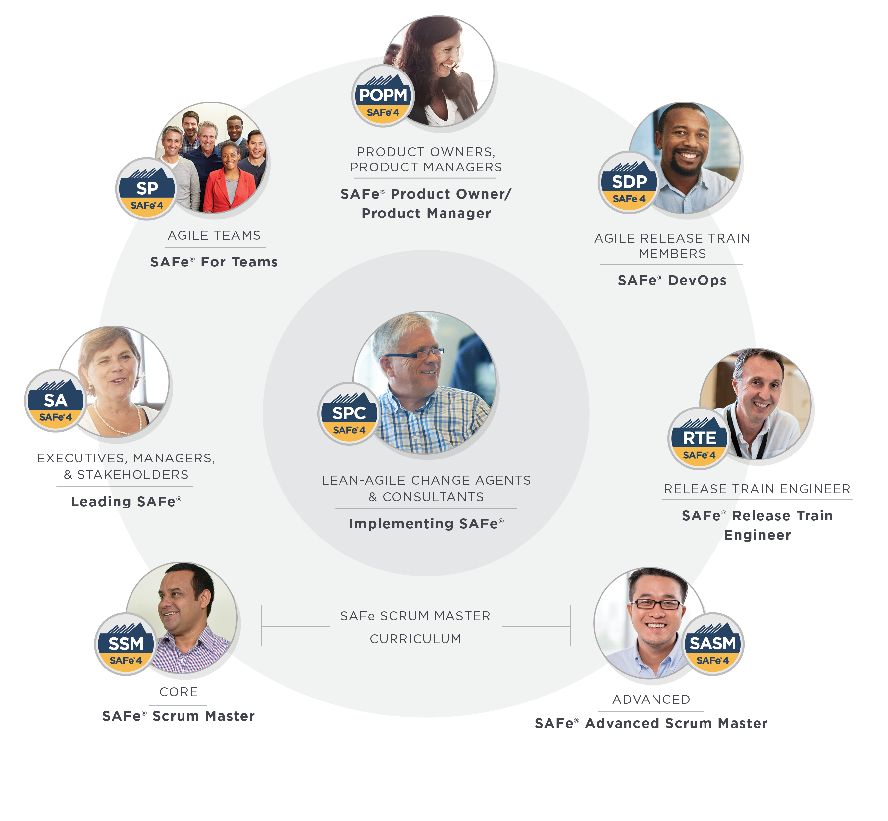
Educate yourself
scaledagile.com/learning
Scaled Agile’s role-based curriculum:
CORE
Leading SAFe®
SAFe® for Teams
SAFe® Scrum Master
SAFe® Product Owner/Product Manager
SAFe® DevOps
ADVANCED
SAFe® Advanced Scrum Master
Implementing SAFe®
SAFe® Release Train Engineer
More courses in development!
Notes:
Scaled Agile’s role-based curriculum helps enterprises unlock business results with SAFe.
Each course is designed to help individuals maximize the value of their role within a SAFe organization, and help them advance throughout their career as they practice, consult, or train others in SAFe.
The result is higher-quality implementations, and greater stability for the organization.

Slide 36

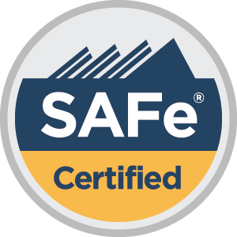
Connect with the global SAFe community to advance learning through the SAFe Community Platform (accessible to those who certify), webinars, conferences, and worldwide SAFe Meetups in places like Mumbai, Paris, Chicago, and Mexico City.
To find a SAFe Meetup near you, go to scaledagile.com/calendar and select SAFe Meetup from the Event Type dropdown menu.
Attend the world’s largest gathering of SAFe professionals at the Global and Regional SAFe Summit events. Details at safesummit.com.
Learn from the
community
250,000+
trained in SAFe

Slide 37
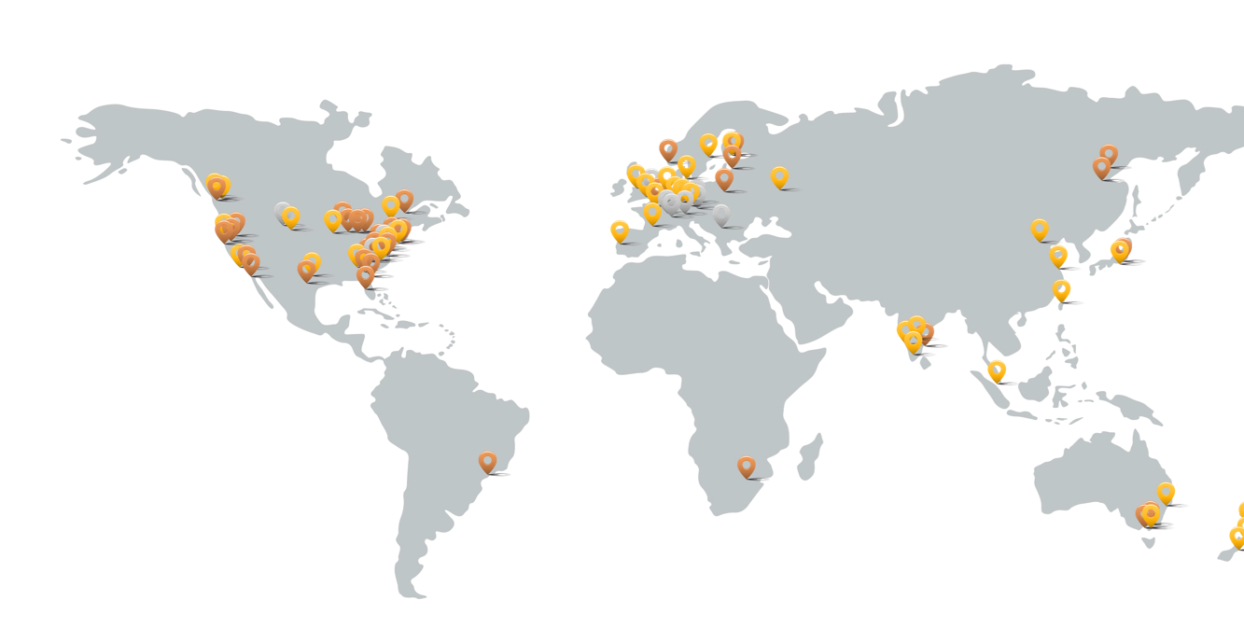
Get help
to ensure success
scaledagile.com/partner-directory
Access worldwide SAFe expertise and support through the Scaled Agile Partner Network:
Training and coaching for all SAFe roles
Implementation and consulting services across industries and disciplines
Platforms for SAFe automation, visibility, and flow
180+
Partners
in 50 countries & 350 cities

Slide 38
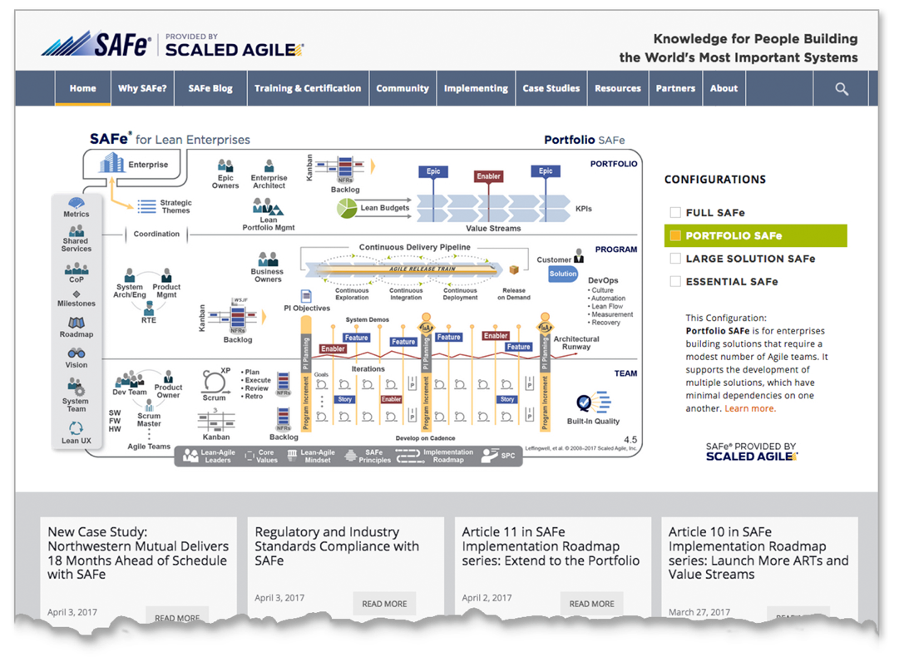
Start your journey:
explore SAFe
scaledagileframework.com
Explore the SAFe knowledge base and find free resources:
Articles
Guidance
Presentations
White papers
Videos
Case studies

